Slide 1


Visual Embedding Representations for Zero-Shot Learning in Computer Vision
Thesis presentation
A.Y. 2023/24
Federico Frati

Slide 2
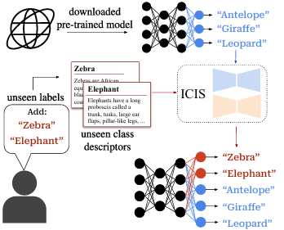
Introduction: Image free zero shot learning
ICIS
Given a specific image classification task and a pre-trained model, can we extend it to desired but missing categories without using images from seen or unseen classes?
Do the classifiers’ weights implicitely bring information about images?
Is it possible to generalize the problem to other task types? E.g. clustering

Slide 3
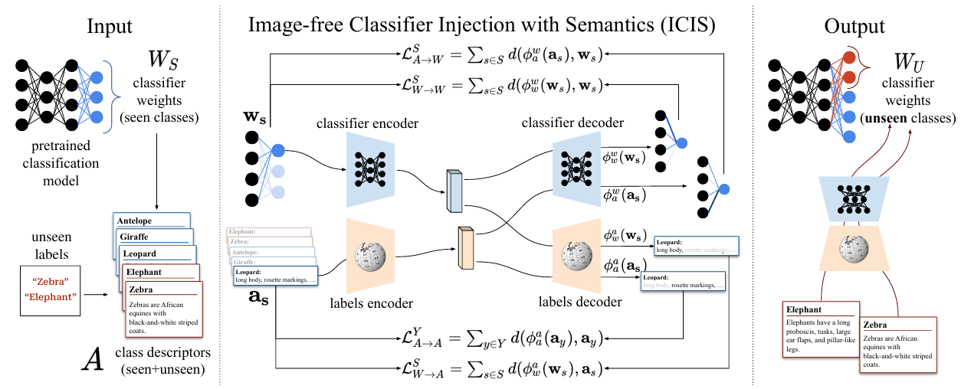
Loss as the sum of four different losses
Encoder decoder based
Completely image free
Good performances compared to pre-existing methods in the literature applicable to image-free ZSL
A proposed architecture for zero-shot images classification: ICIS

Slide 4
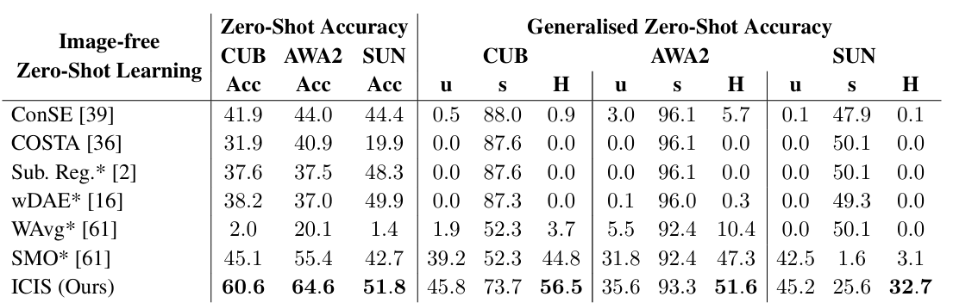
Experimental results
CUB: fine-grained bird classification
AWA2: coarse-grained classification with 50 different animals
SUN: dataset for indoor and outdoor scenes classification

Slide 5


What about clustering?
Self-supervised learning (SSL) has seen a large amount of interest in recent years across almost every machine learning sub-field, due to the promise of being able to harness the large quantities of unlabeled data available
Zero-shot clustering of feature embeddings: tests considering different methods from the major self-supervised paradigms and different clustering algorithms
Silhouette score is strongly correleted with AMI and can be considered a good indicator for performances
AMI unusabe if there is no ground truth available

Slide 6
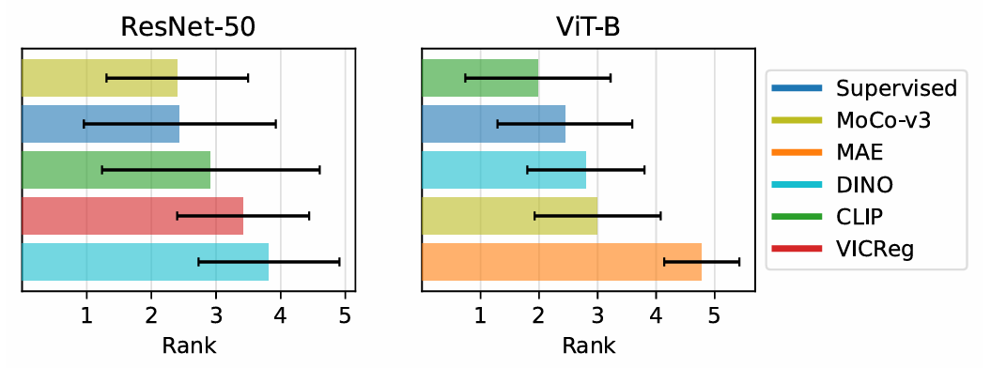
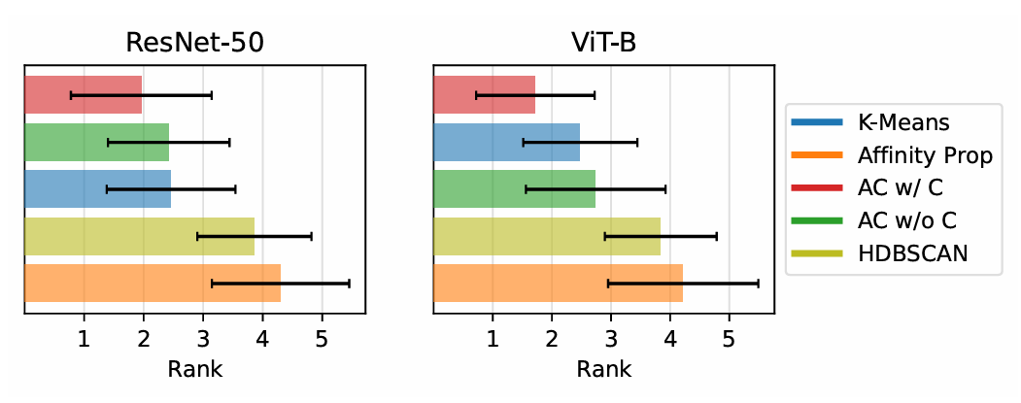
Results
Average rank of each tested SSL encoder (lower is better). For both the ResNet-50 and ViT-B backbones an SSL encoder in general results in the best clustering. It is worth noting that the supervised method also in general produces good clusters
Average clustering method rank (lower is better). AC method performs very well, whether the number of cluster are known a priori or not .

Slide 7

My thesis work
With this thesis work we want to try to place ourselves between the two approaches presented. The details have not yet been defined, but the key idea is to investigate and exploit the information implicitly present in the feature embeddings to perform zero shot tasks without the direct use of images in a Self Supervised approach.

Slide 8
Thank you for the attention
Thesis presentation
Federico Frati
A.Y. 2023/24

